Slide 1
Micro-Credit Defaulter list
In this dataset we need to predict in terms of probability for each loan transaction, whether the customer will be paying back the loaned amount within 5 days of insurance of loan. In this case, Label ‘1’ indicates that the loan has been payed i.e. Non- defaulter, while, Label ‘0’ indicates that the loan has not been payed i.e. defaulter.

Slide 2
Steps taken before EDA was performed
Imported necessary libraries for task to be completed.
Loaded dataset on jupyter notebook using pandas library.
By looking at the columns of dataset, identified the target column (label) to make prediction on named.
Checked dimension of the dataset which was showing that dataset contains 209593 rows & 37 columns.
Checked description of dataset which gives information of mean, min value, max value, etc of every column in dataset which contains continuous data in it.
Checked name of every column present in dataset.

Slide 3
Exploratory Data Analysis

Slide 4
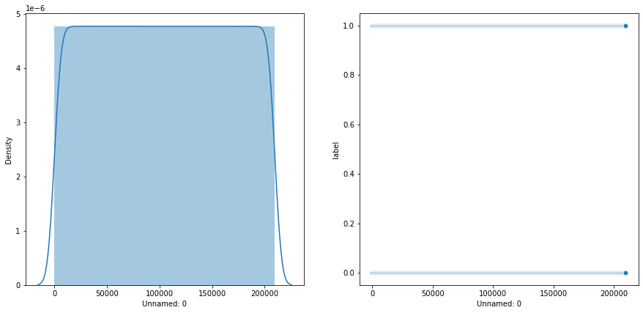
1. Unnamed: 0
Checked unique values of the column.
There was no null value present in the column.
By looking at unique value it was giving numbers like it is an index & from visualization we could not conclude anything

Slide 5
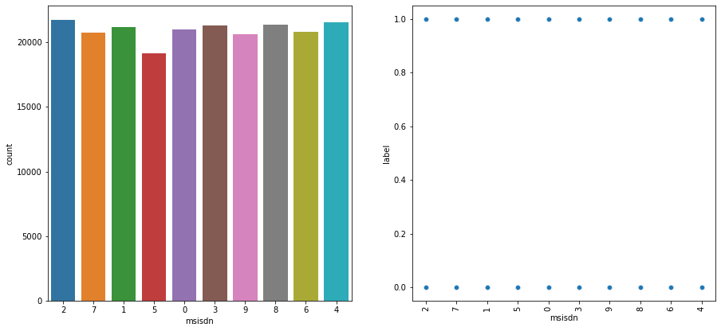
2. Msisdn (mobile number of user)
Checked unique values of the column.
There was no null value present in the column.
We refined the information by classifying mobile numbers on the basis of their starting first digit.
From visualization we conclude that most users use mobile number starting with digit 2 & every category of mobile number user is present in both categories of label.

Slide 6
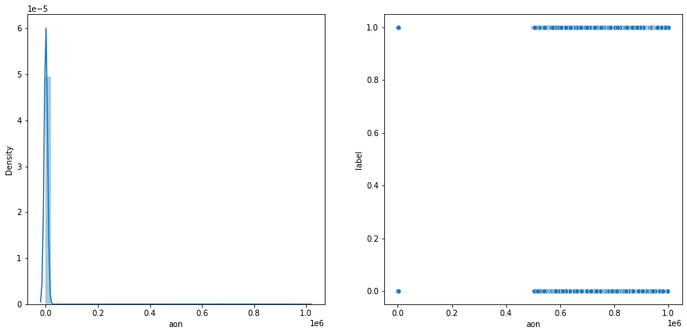
3. aon (age on cellular network in days)
Checked unique values of the column.
There was no null value present in the column.
From visualization we conclude that we couldnot determine skewness of data with having highest density around 1 or 2 & data of aon is present in both categories of label over same range of aon’s data.

Slide 7
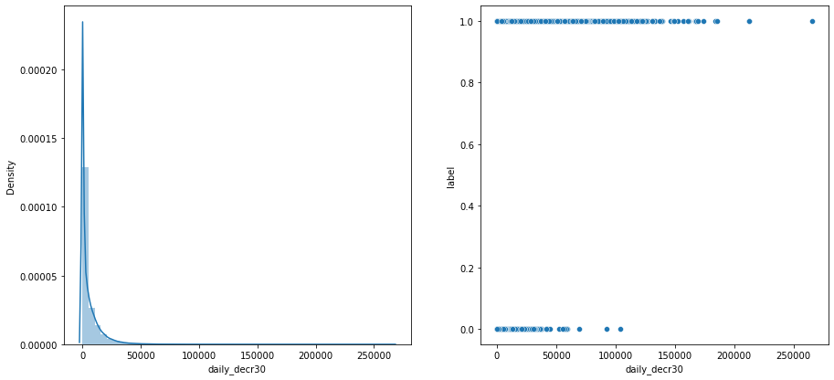
4. daily_decr30 (daily amount spent from main account avg over last 30 days)
Checked unique values of the column.
There was no null value present in the column.
From visualization we concluded that data is positively skewed with having highest density at around 50 & users in category 0 of label are present till 10000’s range where as users in category 1 of label are present well over 10000’s range of daily_decr30

Slide 8
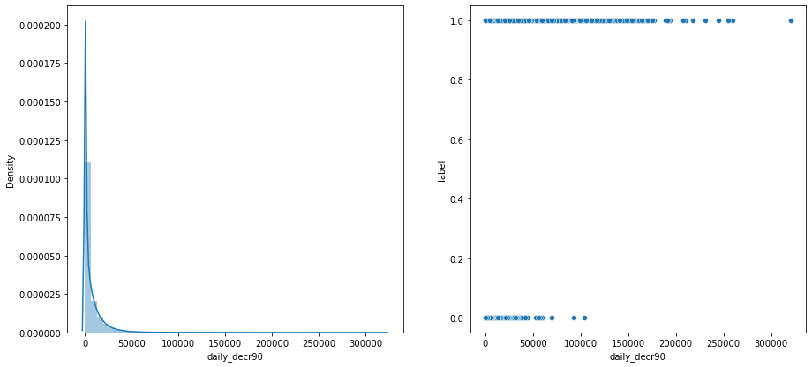
5. daily_decr90 (daily amount spent from main account avg over last 90 days)
Checked unique values of the column.
There was no null value present in the column.
From visualization we concluded that data is positively skewed with having highest density at around 50 & users in category 0 of label are present till 10000’s range where as users in category 1 of label are present well over 10000’s range of daily_decr90

Slide 9
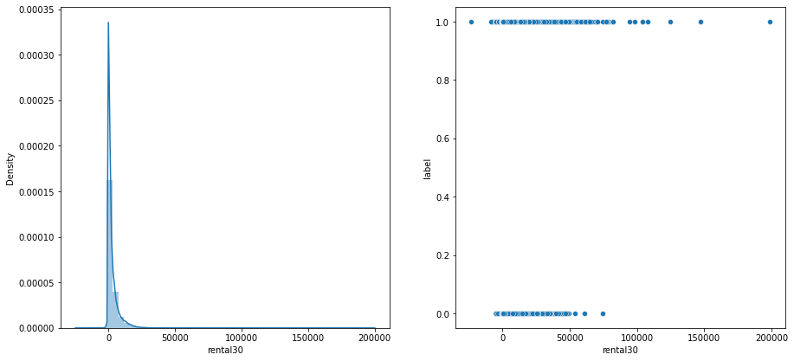
6. rental30 (avg main account balance over last 30 days)
Checked unique values of the column.
There was no null value present in the column.
From visualization we concluded that data is positively skewed with having highest density at around 50 & users in category 0 of label are present till 10000’s range where as users in category 1 of label are present well over 10000’s range of rental30

Slide 10
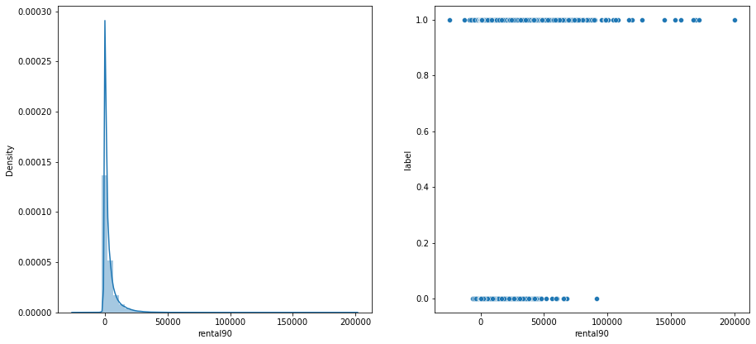
7. rental90 (avg main account balance over last 90 days)
Checked unique values of the column.
There was no null value present in the column.
From visualization we concluded that data is positively skewed with having highest density at around 50 & users in category 0 of label are present till 10000’s range where as users in category 1 of label are present well over 10000’s range of rental90

Slide 11
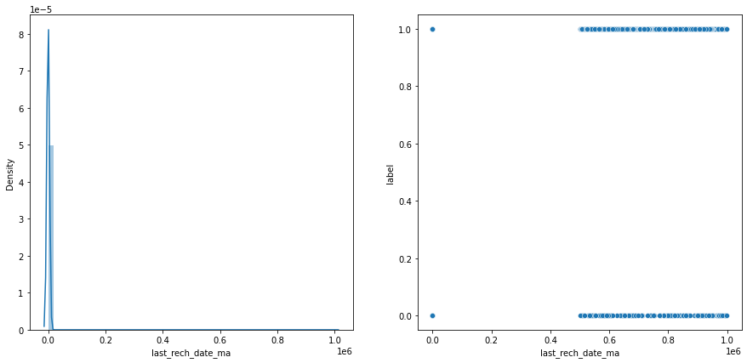
8. last_rech_date_ma (number of days till last recharge of main account)
Checked unique values of the column.
There was no null value present in the column.
From visualization we concluded that we could not determine skewness of data with data having highest density at around 1 or 2 & data is present in both categories of label over same range of last_rech_date_ma’s data.

Slide 12
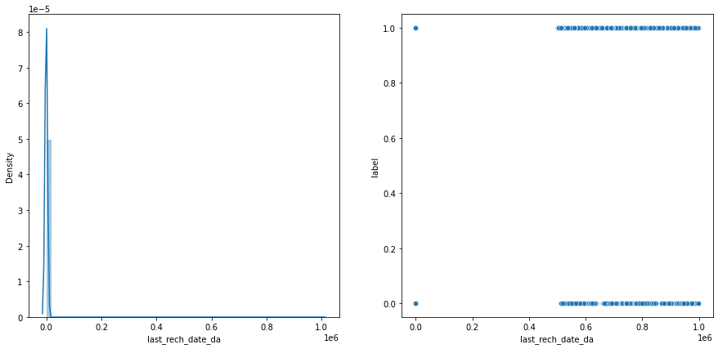
9. last_rech_date_da (number of days till last recharge of data account)
Checked unique values of the column.
There was no null value present in the column.
From visualization we concluded that we could not determine skewness of data with data having highest density at around 1 or 2 & data is present in both categories of label over same range of last_rech_date_da’s data.

Slide 13
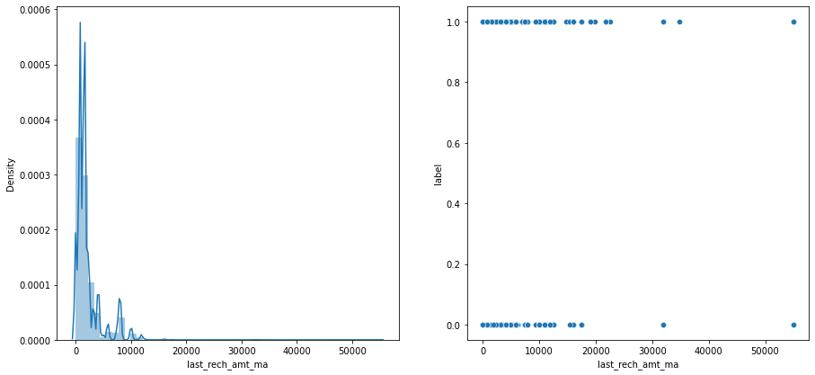
10. last_rech_amt_ma (amount of last recharge of main account)
Checked unique values of the column.
There was no null value present in the column.
From visualization we concluded that data is positively skewed with data having highest density at around 30 & users in category 0 of label are present till 20000’s range with being 1 or 2 over it where as users in category 1 of label are present well over 20000’s range of last_rech_amt_ma.

Slide 14
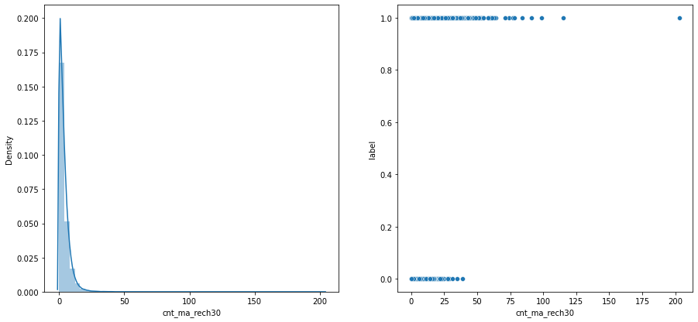
11. cnt_ma_rech30 (number of times main account got recharged in past 30 days)
Checked unique values of the column.
There was no null value present in the column.
From visualization we concluded that data is positively skewed with having highest density at around 10 & users in category 0 of label are present till 50’s range where as users in category 1 of label are present well over 50’s range of cnt_ma_rech30

Slide 15
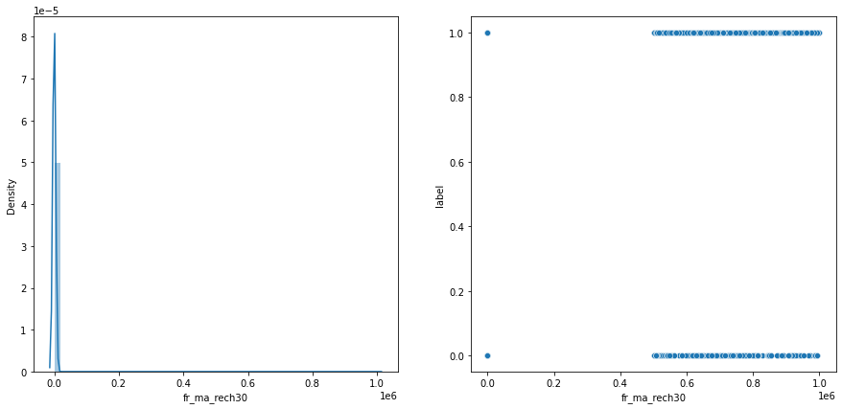
12. fr_ma_rech30 (Frequency of main account recharged in last 30 days )
Checked unique values of the column.
There was no null value present in the column.
From visualization we concluded that we couldnot determine skewness of data with data having highest density at around 0 & data is present in both categories of label over same range of fr_ma_rech30’s data.

Slide 16
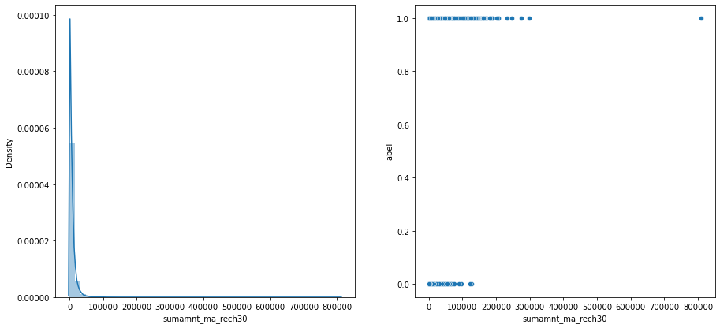
13. sumamnt_ma_rech30 (Total amount of recharge in main account over last 30 days)
Checked unique values of the column.
There was no null value present in the column.
From visualization we concluded that data is positively skewed with having highest density at around 2000 & users in category 0 of label are present till 100000’s range where as users in category 1 of label are present well over 100000’s range of sumamnt_ma_rech30.

Slide 17
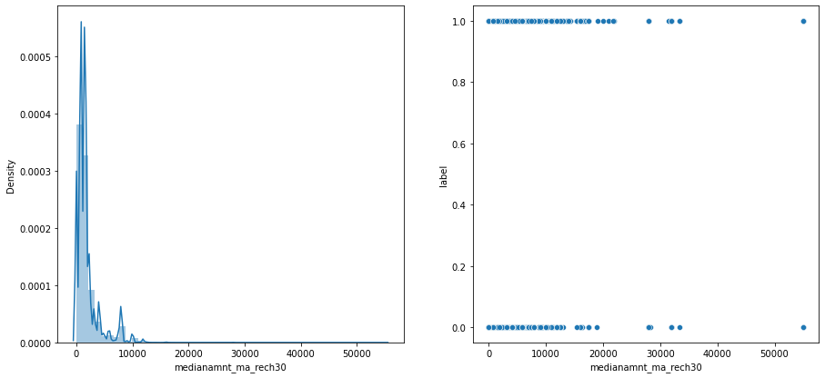
14. medianamnt_ma_rech30 (Median of amount of recharges done in main account over last 30 days at user level)
Checked unique values of the column.
There was no null value present in the column.
From visualization we concluded that data is positively skewed with having highest density at around 1000 & users of medianamnt_ma_rech30 in category 1 of label are present more then category 0 of label.

Slide 18
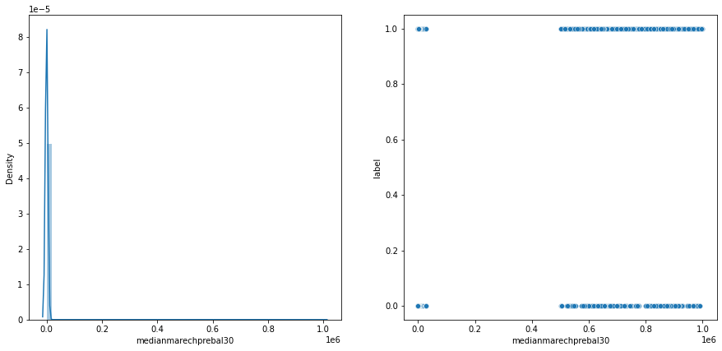
15. medianmarechprebal30 (Median of main account balance just before recharge in last 30 days at user level)
Checked unique values of the column.
There was no null value present in the column.
From visualization we concluded that we couldnot determine skewness of data with data having highest density at around 0 & data is present in both categories of label over same range of medianmarechprebal30

Slide 19
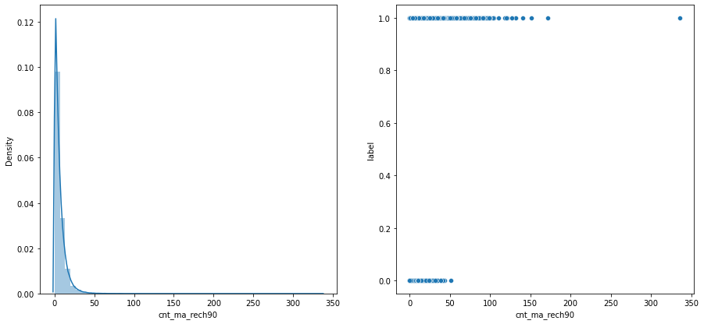
16. cnt_ma_rech90 (Number of times main account got recharged in last 90 days)
Checked unique values of the column.
There was no null value present in the column.
From visualization we concluded that data is positively skewed with having highest density at around 10 & users in category 0 of label are present till 50’s range where as users in category 1 of label are present well over 50’s range of cnt_ma_rech90.

Slide 20
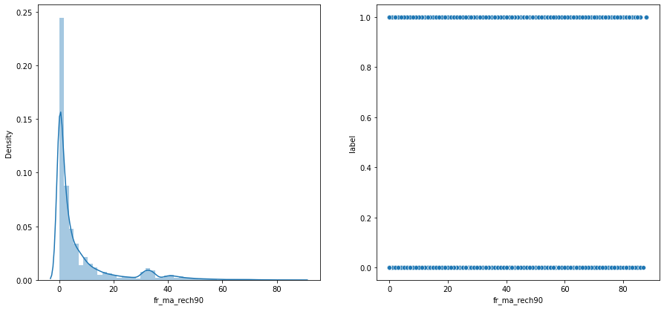
17. fr_ma_rech90 (Frequency of main account recharged in last 90 days)
Checked unique values of the column.
There was no null value present in the column.
From visualization we conclude that data is positively skewed with having highest density at around 5 & data is present in both categories of label over same range of fr_ma_rech90.

Slide 21
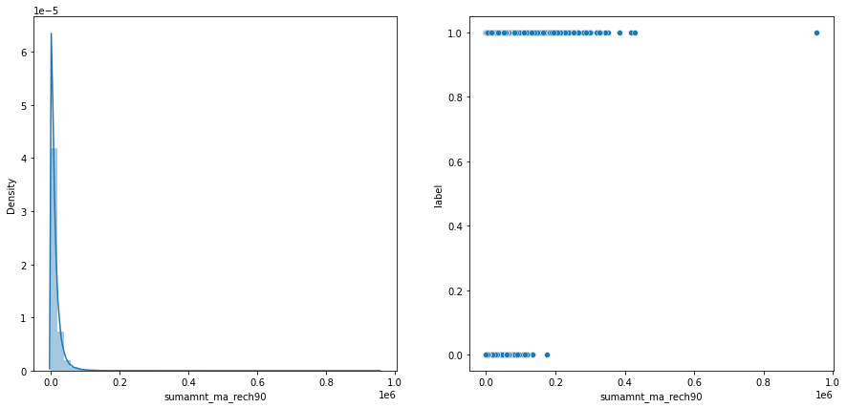
18. sumamnt_ma_rech90 (Total amount of recharge in main account over last 90 days)
Checked unique values of the column.
There was no null value present in the column.
From visualization we concluded that data is positively skewed with having highest density at around 0.03 & users in category 0 of label are present till 0.2’s range where as users in category 1 of label are present well over 0.2’s range of sumamnt_ma_rech90.

Slide 22
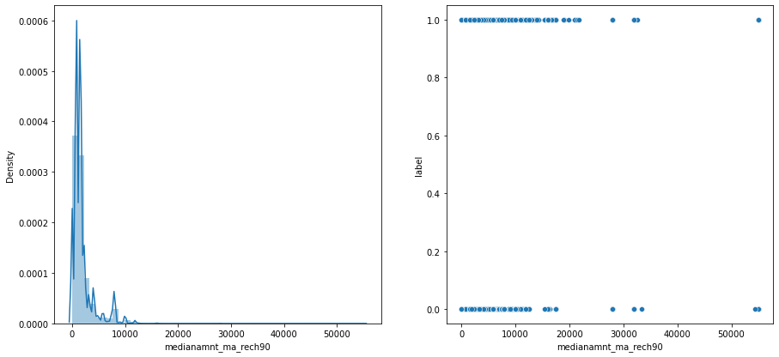
19. medianamnt_ma_rech90 (Median of amount of recharges done in main account over last 90 days at user level)
Checked unique values of the column.
There was no null value present in the column.
From visualization we concluded that data is positively skewed with having highest density at around 2000 & users of medianamnt_ma_rech90 are present more in category 1 then in category 0 of label.

Slide 23
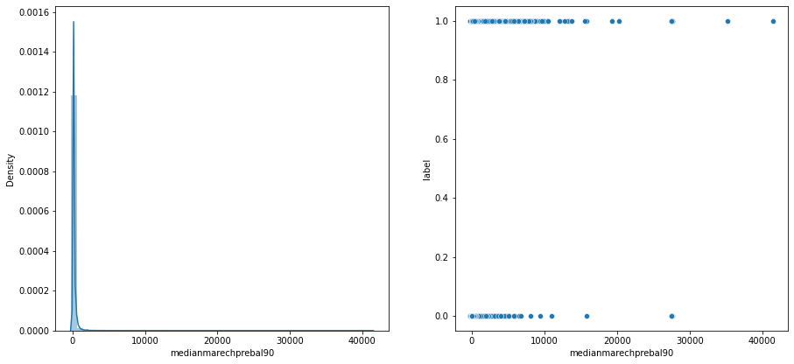
20. medianmarechprebal90 (Median of main account balance just before recharge in last 90 days at user level)
Checked unique values of the column.
There was no null value present in the column.
From visualization we concluded that we could not determine skewness of data with data having highest density at around 100 & users of medianmarechprebal90 are present more in category 1 then category 0 of label.

Slide 24
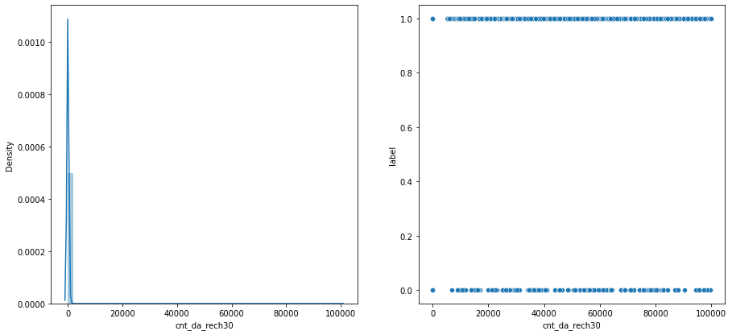
21. cnt_da_rech30 (Number of times data account got recharged in last 30 days)
Checked unique values of the column.
There was no null value present in the column.
From visualization we conclude that we could not determine skewness of data with having highest density at around 300 & data is present in both categories of label over same range of cnt_da_rech30.

Slide 25
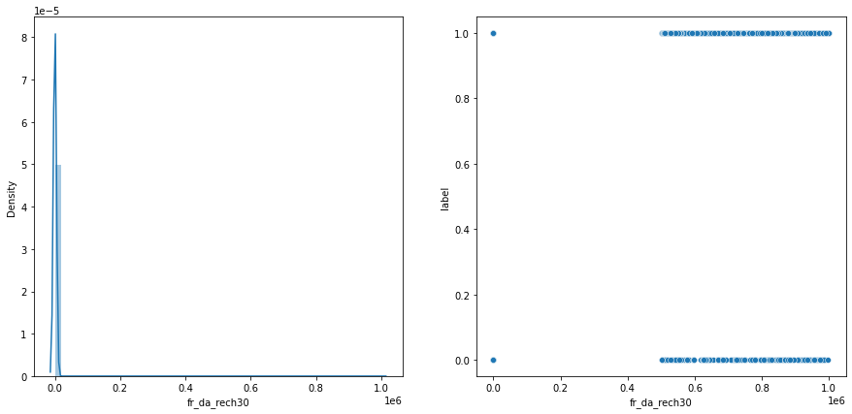
22. fr_da_rech30 (Frequency of data account recharged in last 30 days)
Checked unique values of the column.
There was no null value present in the column.
From visualization we conclude that we could not determine skewness of data with having highest density at around 300 & data is present in both categories of label over same range of fr_da_rech30.

Slide 26
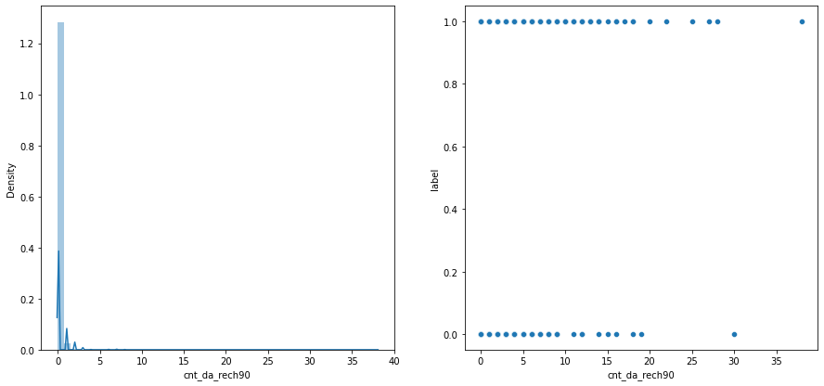
23. cnt_da_rech90 (Number of times data account got recharged in last 90 days)
Checked unique values of the column.
There was no null value present in the column.
From visualization we concluded that data is positively skewed with having highest density at around 2 & cnt_da_rech90 users are present more in category 1 then category 2 of label.

Slide 27
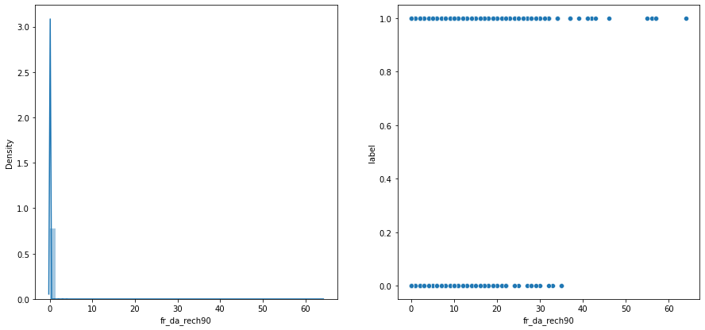
24. fr_da_rech90 (Frequency of data account recharged in last 90 days)
Checked unique values of the column.
There was no null value present in the column.
From visualization we concluded that data is positively skewed with having highest density at around 2 & users in category 0 of label are present till 40’s range where as users in category 1 of label are present well over 40’s range of fr_da_rech90.

Slide 28
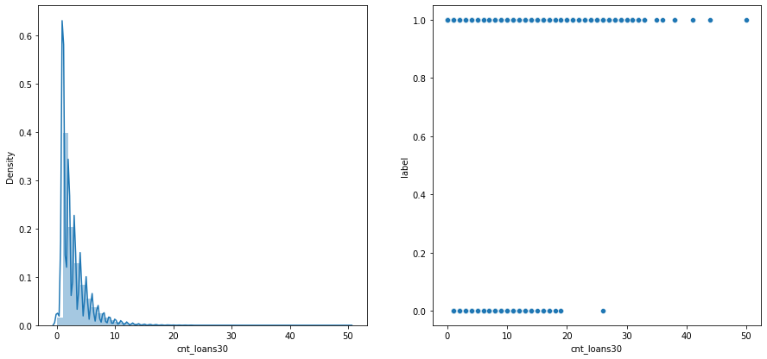
25. cnt_loans30 (Number of loans taken by user in last 30 days)
Checked unique values of the column.
There was no null value present in the column.
From visualization we concluded that data is positively skewed with having highest density at around 3 & users in category 0 of label are present till 30’s range where as users in category 1 of label are present well over 30’s range of cnt_loans30.

Slide 29
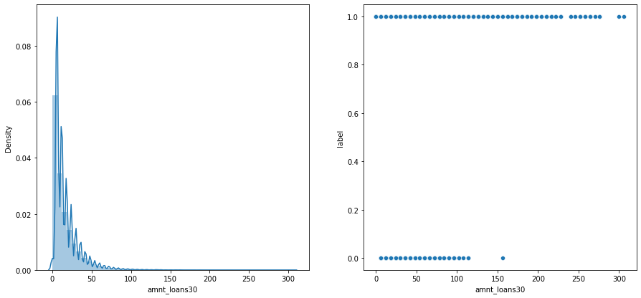
26. amnt_loans30 (Total amount of loans taken by user in last 30 days)
Checked unique values of the column.
There was no null value present in the column.
From visualization we concluded that data is positively skewed with having highest density at around 5 & users in category 0 of label are present till 160’s range where as users in category 1 of label are present well over 160’s range of amnt_loans30.

Slide 30
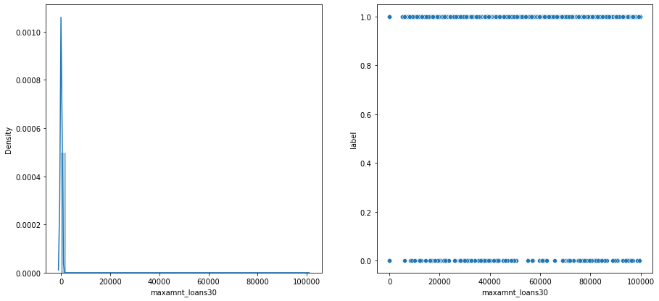
27. maxamnt_loans30 (maximum amount of loan taken by the user in last 30 days)
Checked unique values of the column.
There was no null value present in the column.
From visualization we could not determine skewness of data with having highest density at around 100 & data is present in both categories of label over same range of maxamnt_loan30 with data present a bit more in category 1 then category 0.

Slide 31
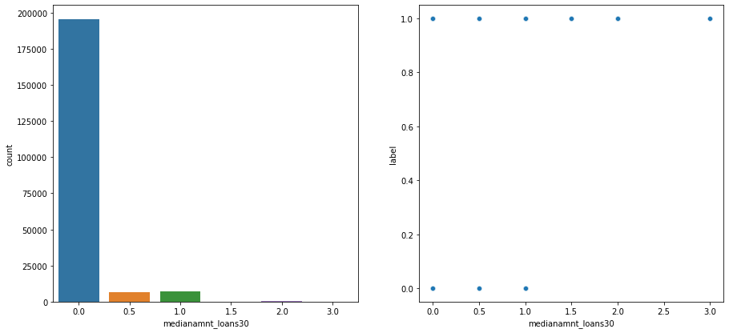
28. medianamnt_loans30 (Median of amounts of loan taken by the user in last 30 days)
Checked unique values of the column.
There was no null value present in the column.
From visualization we conclude that most users are present in 0.0 category of medianamnt_loans30 & only 0, 0.5, 1 categories of medianamnt_loans30 are present in both categories of label, else every other category of medianamnt_loans30 is present in only category 1 of label except for category 2 of medianamnt_loans30 which is not present in any category of label.

Slide 32
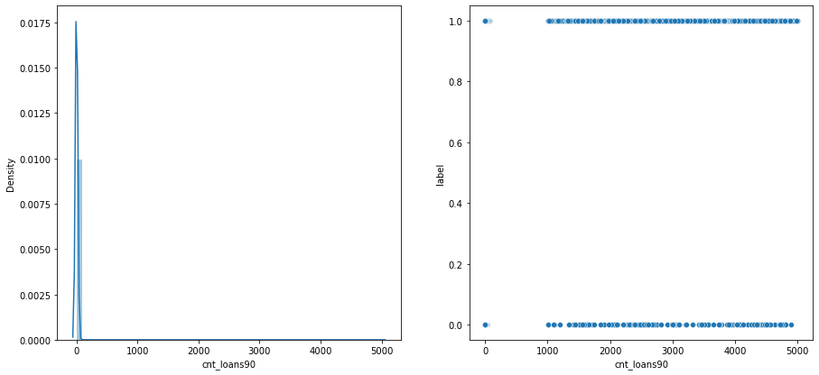
29. cnt_loans90 (Number of loans taken by user in last 90 days)
Checked unique values of the column.
There was no null value present in the column.
From visualization we conclude that we could not determine data skewness with data having highest density at around 100 & data is present in both categories of label over same range of cnt_loans90.

Slide 33
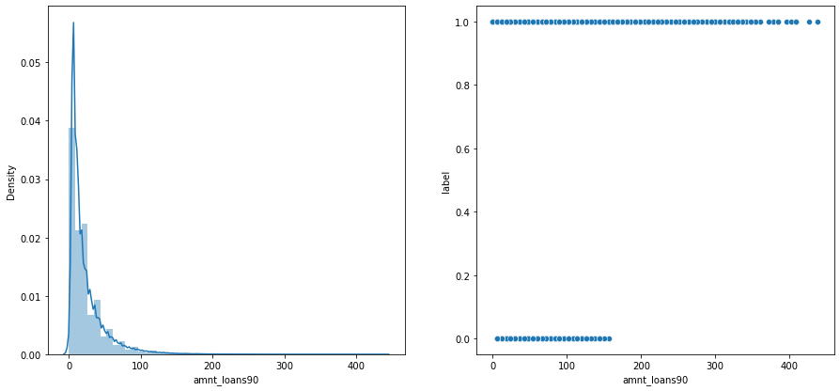
30. amnt_loans90 (Total amount of loans taken by user in last 90 days)
Checked unique values of the column.
There was no null value present in the column.
From visualization we conclude that data is positively skewed with having highest density at around 15 & users in category 0 of label are present till 180’s range where as users in category 1 of label are present well over 180’s range of amnt_loans90.

Slide 34
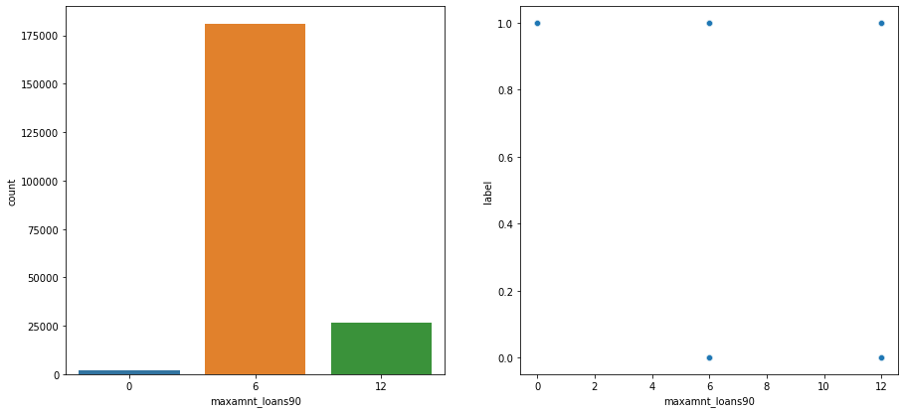
31. maxamnt_loans90 (maximum amount of loan taken by the user in last 90 days)
Checked unique values of the column.
There was no null value present in the column.
From visualization we concluded that most users are present in category 6 of maxamnt_loans90 & every category of maxamnt_loans90 is present in both categories of label except for only category 0 of maxamnt_loans90 which is present in only category 1 of label.

Slide 35
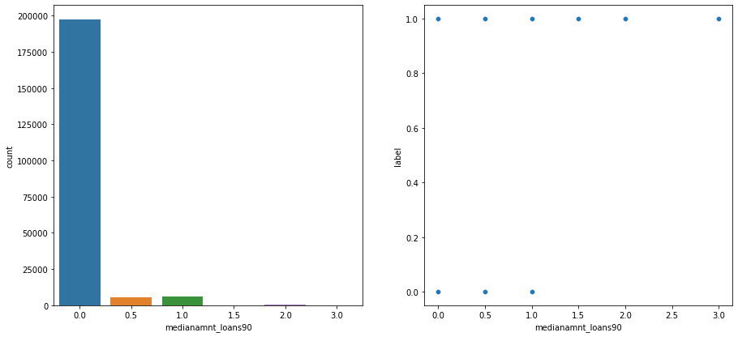
32. medianamnt_loans90 (Median of amounts of loan taken by the user in last 90 days)
Checked unique values of the column.
There was no null value present in the column.
From visualization we conclude that most users are present in category 0 of medianamnt_loans90 & every category of medianamnt_loans90 is present in both categories of label till category 1 of medianamnt_loans90 & beyond that category every category of medianamnt_loans90 is present in only category 1 of label except for category 2.5 which is not present in any category of label.

Slide 36
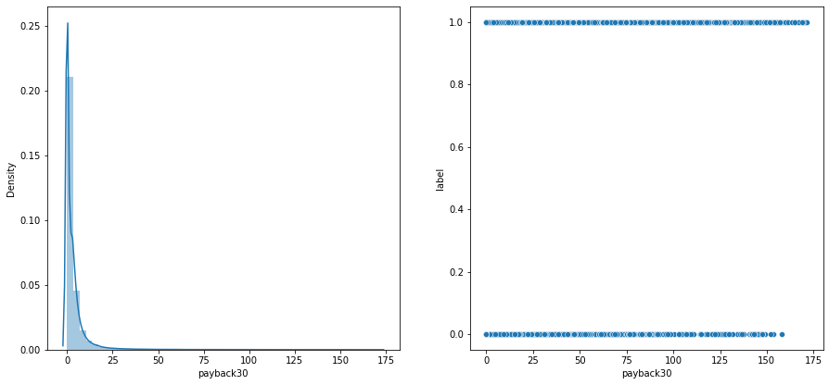
33. payback30 (Average payback time in days over last 30 days)
Checked unique values of the column.
There was no null value present in the column.
From visualization we conclude that data is positively skewed with having highest density at around 4 & data is present in both categories of label over same range of payback30 with data being present little bit more in category 1 then category 0 of label.

Slide 37
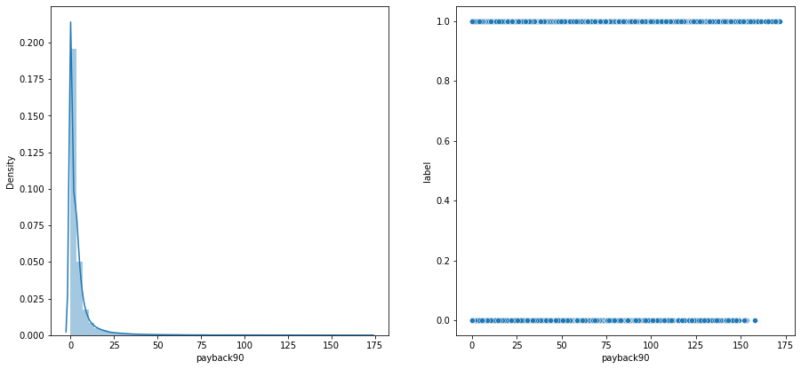
34. payback90 (Average payback time in days over last 90 days)
Checked unique values of the column.
There was no null value present in the column.
From visualization we conclude that data is positively skewed with having highest density at around 4 & data is present in both categories of label over same range of payback30 with data being present little bit more in category 1 then category 0 of label.

Slide 38
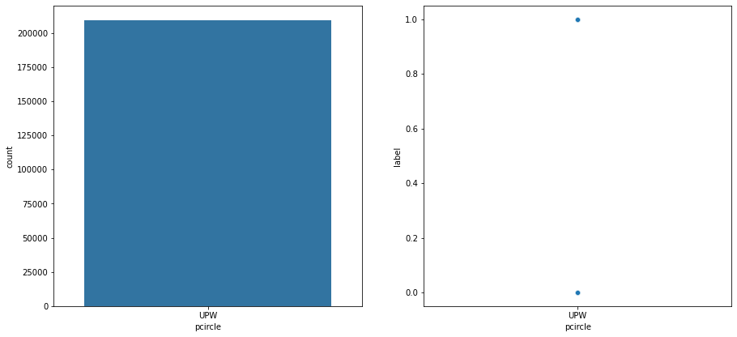
35. pcircle (telecom circle)
Checked unique values of the column.
There was no null value present in the column.
From visualization we could not conclude Anything as there is only one same value present in every row of the whole & it is present in both categories of label.

Slide 39
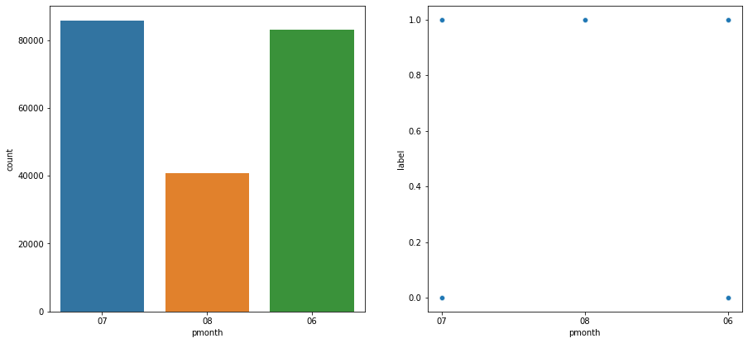
36. pdate (date)
Checked unique values of the column.
There was no null value present in the column.
Refined data to extract month information from it as the data given was of a single year.
From visualization we concluded most users are present in category 7 of pmonth & every category of pmonth is present in both categories of label except for category 8 which is present only in category 1 of label.

Slide 40
Plotting Heatmap
Plotted heatmap to check correlation of every column with target column.
We concluded that target column have high positive correlation with following (pmonth, amnt_loans90, amnt_loans30, cnt_loans30, medianamnt_ma_rech90, sumamnt_ma_rech90, cnt_ma_rech90, medianamnt_ma_rech30, sumamnt_ma_rech30, cnt_ma_rech30, daily_rech90 & daily_rech30) columns.
Then we dropped following ( pcircle, payback, medianamnt_loans90, cnt_da_rech90, fr_ma_rech90, rental30) columns to reduce multi collinearity.

Slide 41
Splitting & scaling data
Splitted the original dataset into X & y in which y contains target column & X contains other columns.
Then we splitted the X & y data into training set & testing.
Then we scaled both X_train & X_test set using standard scalar to remove outliers if present in dataset.

Slide 42
Applying GridSearchCV
We chose 4 classification models (Logistic Regression Model, Decision Tree Classification Model, Random Forest Classification Model & Bagging Classification Model) to check performance of them on the dataset to find out the best suited model for the dataset.
Then one by one we applied GridSearchCV on each model to find best hyper parameter tuning while model is working on the dataset.
After applying GridSearchCV on every model we concluded that out of all models Decision Tree Classification Model is giving the best test accuracy score for the dataset which is 0.9064 with hyper parameter combination (max_depth : 5, min_samples_leaf : 1, min_samples_split : 2)

Slide 43
Applying Model on dataset
Chose Decision Tree Classification Model & made it ready by tuning hyper parameter.
After tuning hyper parameter applied model on dataset to make prediction.
After making prediction we made the dataframe showing predicted values & actual values.
Then we applied various metrices on model to check its performances which were accuracy score, cohen kappa score & confusion matrix.
After looking the scores of every metrice we concluded that model is performing good on the dataset.
After making the conclusion we saved the model using pickle library.

Slide 44
THE END

